Slide 1
Ch-6
Servlet

Slide 2
Agenda
Why study Servlet?
Evolution story of web-content
Demand for personalized and dynamic web content
CGI
Managed Environment ( With example: Renting a house v/s Renting a hotel apartment)
Server side application scriptlet (ServLet)

Slide 3
Introduction
Servlet - Server side Applet
Applet – Application Scriptlet
Why Server side application?
HTML – Not a programming language (Presentation Language)
Use of JavaScript for programming on client side
Limitation of client-side scripting
Evolution of Server side programming.
Sending dynamic content over same HTTP protocol. (Meaning sending dynamically generated HTML pages. The pages are generated by Servlet.)

Slide 4
Evolution of Web Content
Publishing industry
Web Publishing using Hyper Text Markup Language
Static content websites
Static websites fail to fetch the traffic
Evolution of web advertising
Dynamic content websites – Site responds based on user activity
Active web content – Interactive, personalized, two way web applications - Better for keeping site visitors’ interest – Example: Gmail, Facebook etc.

Slide 5
CGI
Common Gateway Interface
First server side programming platforms.
Supported multiple languages like C, Perl, etc.
All requests to server are passed through CGI and hence called Common Gateway Interface

Slide 6
Advantages of servlet over CGI
CGI programs are platform dependent while servlets are platform independent.
Each request is answered in CGI in separate process by separate instance , in servlet no need to generate separate process for each request.
A CGI program needs to be loaded and started on each CGI request, servlets stay in memory while serving requests.
Servlets saves memory as it creates single instance for all the requests as wells as gives efficient performance.

Slide 7
Managed Environment
CGI programmes needed to manage (write sperate code for each application) the simultaneous processes.
Manage means – Code was needed to write for loading a piece of code, executing, memory management, handling client connection etc.
For Servlet, all the above tasks are written in Servlet Container (Wrote once, re-using every time) of Java Enterprise Edition.
Hence, Container and Java EE provides a managed environment for Servlet to execute.

Slide 8
Advantages of Managed Environment
Renting a house v/s Staying in a hotel apartment
Management overhead.
Due to management overhead, less focus on essential/core business. Hence, increases development time.
With Servlet, in managed environment, APIs for most of the processing are available with Java EE and Servlet Container.
Hence, focus will be only on the business logic and not on managing and processing different requests.

Slide 9
Benefits of Servlet
Performance
The performance of servlets is superior to CGI because there is no process creation for each client request.
Each request is handled by the servlets container process.
After a servlet has completed processing a request, it stays resident in memory, waiting for another request.
Portability
Like other Java technologies, servlets applications are portable.
Rapid development cycle
As a Java technology, servlets have access to the rich Java library that will help speed up the development process.
Robustness
Servlets are managed by the Java Virtual Machine.
Don't need to worry about memory leak or garbage collection, which helps you write robust applications.
Widespread acceptance
Java is a widely accepted technology.

Slide 10
Features of Servlet
Efficient – Due to focus on core functionality
Persistent – No need to load for each request
Portable – Can work on any server platform
Robust – Good Exception handling capability
Extensible – Re-usable components (Inheritance)
Secured – Runs within JVM
Standard based – Follows Java Industry standards

Slide 11
Servlet Container Architecture
HTTP Request
Servlet
Container
Servlet
Browser
HTTP
Server
HTTP Response
Static
Content

Slide 12
How Servlets Work
is servlet
loaded?
Receive
Request
No
Yes
is servlet
current?
No
Load Servlet
Yes
Send
Response
Process Request

Slide 13
Support Environments for Java Servlet
A Java Servlet application is supported by its Servlet container.
The Apache Tomcat web server is the official reference implementation of Servlet containers, supporting Servlets and JSP.

Slide 14
A Servlet has a lifecycle just like a Java applet. The lifecycle is managed by the Servlet container.
There are three methods in the Servlet interface, which each Servlet class must implement. They are init(), service(), and destroy().

Slide 15
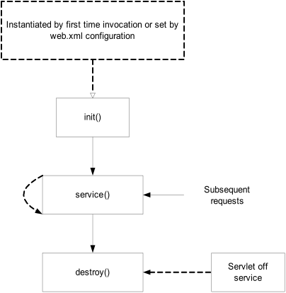

Slide 16
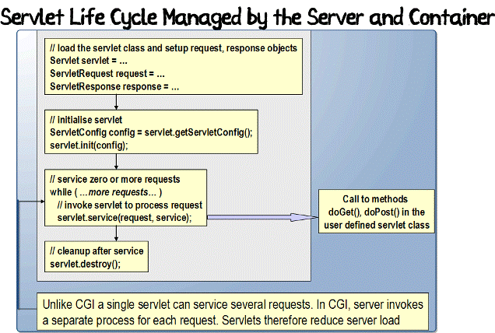

Slide 17
Servlet Architecture
A Java Servlet is a typical Java class that extends the abstract class HttpServlet.
The HttpServlet class extends another abstract class called GenericServlet.
The GenericServlet class implements three interfaces: javax.servlet.Servlet,
javax.servlet.ServletConfig, and java.io.Serializable.

Slide 18
GenericServlet | HttpServlet
The GenericServlet is an abstract class that is extended by HttpServlet to provide HTTP protocol-specific methods. | An abstract class that simplifies writing HTTP servlets. It extends the GenericServlet base class and provides an framework for handling the HTTP protocol.
The GenericServlet does not include protocol-specific methods for handling request parameters, cookies, sessions and setting response headers. | The HttpServlet subclass passes generic service method requests to the relevant doGet() or doPost() method.
GenericServlet is not specific to any protocol. | HttpServlet only supports HTTP and HTTPS protocol

Slide 19
HttpServlet - Methods
void doGet (HttpServletRequest request, HttpServletResponse response)
handles GET requests
void doPost (HttpServletRequest request,
HttpServletResponse response)
handles POST requests
void doPut (HttpServletRequest request,
HttpServletResponse response)
handles PUT requests
void doDelete (HttpServletRequest request,
HttpServletResponse response)
handles DELETE requests

Slide 20
GenericServlet - Methods
void init(ServletConfig config)
Initializes the servlet.
void service(ServletRequest req, ServletResponse res)
Carries out a single request from the client.
void destroy()
Cleans up whatever resources are being held (e.g., memory, file handles, threads) and makes sure that any persistent state is synchronized with the servlet's current in-memory state.
ServletConfig getServletConfig()
Returns a servlet config object, which contains any initialization parameters and startup configuration for this servlet.
String getServletInfo()
Returns a string containing information about the servlet, such as its author, version, and copyright.

Slide 21
doGet() | doPost()
In doGet() the parameters are appended to the URL and sent along with header information. | In doPost(), on the other hand will (typically) send the information through a socket back to the webserver and it won't show up in the URL bar.
The amount of information you can send back using a GET is restricted as URLs can only be 1024 characters. | You can send much more information to the server this way - and it's not restricted to textual data either. It is possible to send files and even binary data such as serialized Java objects!
doGet() is a request for information; it does not (or should not) change anything on the server | doPost() provides information (
Parameters are not encrypted | Parameters are encrypted
It allows bookmarks. | It disallows bookmarks.
doGet() is faster if we set the response content length since the same connection is used. Thus increasing the performance | doPost is slower compared to doGet since doPost does not write the content length

Slide 22
Servlet Request object
provides client request information to a servlet.
the servlet container creates a servlet request object and passes it as an argument to the servlet's service method.
the ServletRequest interface define methods to retrieve data sent as client request:
parameter name and values
attributes
input stream
HTTPServletRequest extends the ServletRequest interface to provide request information for HTTP servlets

Slide 23
HttpServletRequest - Methods
getParameterNames()
an Enumeration of String objects, each String containing the name of a request parameter; or an empty Enumeration if the request has no parameters
getParameterValues (java.lang.String name)
Returns an array of String objects containing all of the values the given request parameter has, or null if the parameter does not exist.
getParameter (java.lang.String name)
Returns the value of a request parameter as a String, or null if the parameter does not exist.

Slide 24
getCookies()
Returns an array containing all of the Cookie objects the client sent with this request.
getMethod()
Returns the name of the HTTP method with which\thi request was made, for example, GET, POST, or PUT.
getQueryString()
Returns the query string that is contained in the request URL after the path.
getSession()
Returns the current session associated with this request, or if the request does not have a session, creates one.

Slide 25
Steps to execute servlet
Create a directory structure under Tomcat/Glassfish for your application.
Write the servlet source code.
Compile your source code.
deploy the servlet
Run Tomcat
Call your servlet from a web browser

Slide 26
Servlet Response Object
Defines an object to assist a servlet in sending a response to the client.
The servlet container creates a ServletResponse object and passes it as an argument to the servlet's service method

Slide 27
HttpServletResponse - Methods
getWriter()
Returns a PrintWriter object that can send
character text to the client
setContentType (java.lang.String type)
Sets the content type of the response being sent to the client. The content type may include the type of character encoding used, for example, text/html; charset=ISO-8859-4
getBufferSize()
Returns the actual buffer size used for the response

